Slide 1
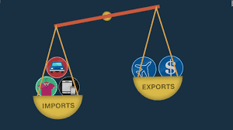
Trade Deficit
Jamel Ben Chafra

Slide 2
What is trade deficit?
The amount by which the cost of a country’s imports exceed the value of its exports.
A situation in which a country buys more from other countries than it sells to other countries.
The difference between exports and imports (in favor of imports).
Notes:
Don’t forget to mention that trade deficit is affecting seriously the Turkish Economy!

Slide 3
Trade deficit in Turkey
Year | Trade Deficit (in Billion $)
2010 | 33.45
2011 | 61.37
2012 | 36.18
2013 | 47.33
2014 | 31.50
2015 | 17.51
2016 | 18.80
2017 | 31.64
2018 | 1.94
2019 | - 19.66
2020 | 27.44
2021 | 3.44

Slide 4
Causes of trade deficit
Lower Tarrifs / Trade Barriers
Lower Productivity
Strong Currency
Reliance on Specific Exports

Slide 5
How can we reduce trade deficit?
Consume less and save more
Depreciate the exchange rate
Apply tax on capital inflows

Slide 6
How can we reduce trade deficit?
Consume less and save more
Depreciate the exchange rate
Apply tax on capital inflows
Increase economy’s productivity

Slide 7
Save, save and save!

